Slide 1

Read, Swap and Share
Presents
All rights reserved, National Library Board Singapore

Slide 2
Read Swap Share (RSS) Process
Facilitator gives out book & Read Swap Share (RSS) activity sheet
Students read the book
Swap book with partner to read
Do the RSS activity sheet based on 1 of the 2 books students have read
Share!
All rights reserved, National Library Board Singapore
Notes:
Facilitator to give out book & Read Swap Share (RSS) activity sheet
Students read book
Swap book to read
Do the RSS activity sheet based on 1 of the 2 books students have read.
Share!

Slide 3



Rules
Listen to the Facilitator when he or she is talking
No snatching or choosing books
Do your work or reading silently
Raise your hand if you have any questions or need an extra book
Whisper during discussion
All rights reserved, National Library Board Singapore

Slide 4


Pair up
Get into groups
OR
All students are to bring their pencil case
All rights reserved, National Library Board Singapore
Notes:
Let’s pair up or get in groups!

Slide 5


You should have:
An activity sheet & a pen/pencil
A book
All rights reserved, National Library Board Singapore

Slide 6
Time for you to read your book!
All rights reserved, National Library Board Singapore

Slide 7

Swapping Time
Swap your book with your partner and read it.
All rights reserved, National Library Board Singapore

Slide 8
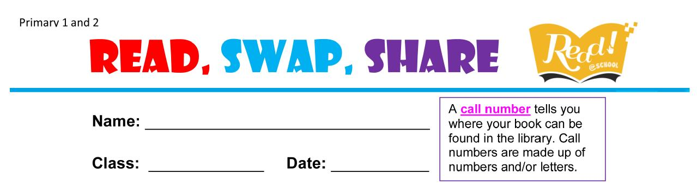
Write your name, class and date on the activity sheet:
Mary Lee
1 Hope
9/4/2013
All rights reserved, National Library Board Singapore

Slide 9


What is the title of the book?
Going to the Firehouse
All rights reserved, National Library Board Singapore

Slide 10

What is the title of the book?
More examples…
Book title words are usually bigger than author’s name!
All rights reserved, National Library Board Singapore

Slide 11
Who is the author of the book?
Mercer Mayer
All rights reserved, National Library Board Singapore

Slide 12
More examples…
Who is the author of the book?
Shekinah Linn
OR
Tan Seow Wei
Answer: Shekinah Linn
“Illustrated by” means
Tan Seow Wei drew the pictures in the book
All rights reserved, National Library Board Singapore

Slide 13

Where is the call number?
All rights reserved, National Library Board Singapore

Slide 14

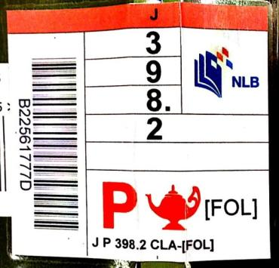
What is the call number?
Old label
New label
JP KET
J P 398.2 MAC – [FOL]
J P 398.2 MAC – [FOL]
All rights reserved, National Library Board Singapore

Slide 15
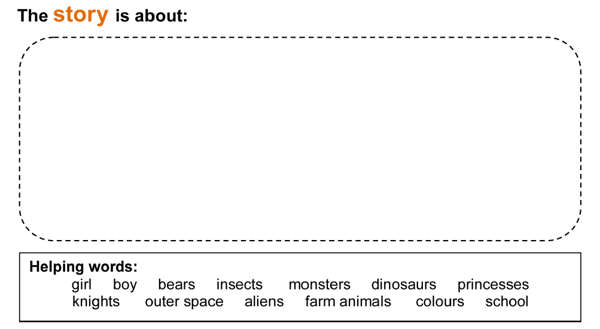
Tell us more…
Animals playing games in a school.
All rights reserved, National Library Board Singapore

Slide 16
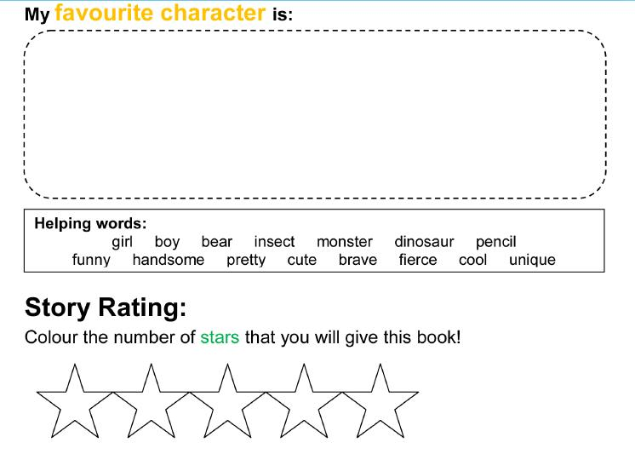
Tell us more…
Dinosaur.
Because it can run very fast, and it roars!
All rights reserved, National Library Board Singapore

Slide 17


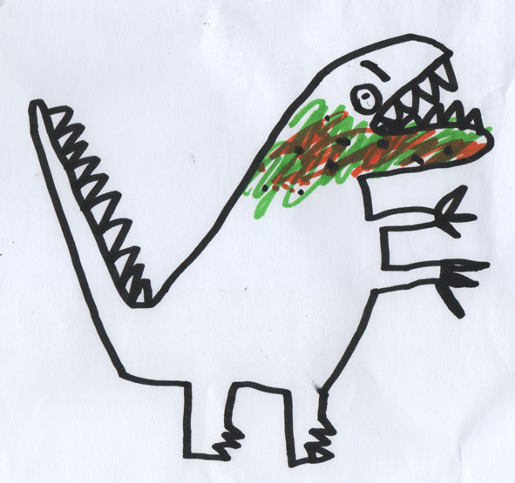
You can also draw…
All rights reserved, National Library Board Singapore
Notes:
Recommended for Pri 1 and 2
http://artful-kids.com/blog/wp-content/uploads/2011/10/Dinosaur.jpg

Slide 18


Sharing Time
In your pairs or groups, share what you have read and written!
I thought the book was fantastic!
I loved it! What’s your favourite part?
All rights reserved, National Library Board Singapore

Slide 19

Pass the books back to the Facilitator
Keep the Activity Sheet or hand it in to the facilitator
All rights reserved, National Library Board Singapore

Slide 20
The End!
All rights reserved, National Library Board Singapore

